Slide 1
Title I Annual Parent Meeting
San Jose ES
August 30, 2023
6:00
Media Center
Principal Lisa Brown
Notes:
Evidence: Upload completed presentation and recorded feedback as part of the evidence to support the Annual Meeting Materials. Do not forget the sign-in sheets, and survey/feedback that you receive throughout the meeting.

Slide 2
Title I Funding Process
2. Florida Department of Education
1. Federal Government
3. Pinellas County Schools
San Jose Elementary
Notes:
The Florida Department of Education receives funds from the federal government. Districts receive Title I funds from Department of Education, and the school district distributes these funds to schools based on the percentage of children eligible for free/reduced price lunch; however, students do not have to be from low-income families to receive help.

Slide 3
Title I Supplemental Resources
Definition: provided in addition to what is already present or available to complete or enhance it.
https://languages.oup.com/
Notes:
Title I is supplemental federal funding that provides e
Definition: provided in addition to what is already present or available to complete or enhance it extra academic support and learning opportunities for economically disadvantaged students.

Slide 4
Education, then, beyond all other divides of human origin, is a great equalizer of conditions of men.”
– Horace Mann

Slide 5
Title I Programs Provide Supplemental Support
Intervention Teachers:
Primary Teacher- Mrs. Hashey
Intermediate Teacher- Mrs. Kennedy
Promise Time:
Tutoring on Tuesdays and Thursdays
Clubs: Art, Music
Enrichment: Mad Scientist
Supplies & Technology
Laptops
Science Boards
AVID: highlighters, binders, post it notes etc.
Notes:
Use additional slides if necessary. This is where you want to really highlight Title I funding and how it positively impacts your scholars!
Additional supplemental personnel (add specific positions)
Additional training opportunities for school staff (add specific trainings offered at your site)
Extended Learning Opportunities (before and/or after school programs)
Supplemental teaching materials, equipment, and technology
Parent and Family Engagement Resources and Training Workshops

Slide 6
Let’s Celebrate!
 | ELA Gr 3-5 Proficiency | Math Gr 3-5 Proficiency | Science Gr 5 Proficiency | ELA Gr 3 Proficiency
2022-23 | 60% | 77% | 79%
2023-24 Goals | 65% | 80% | 80% | 70%
Notes:
Based on the FSA data and school grades, there is a lot to celebrate!!
How did your Title I Resources support or enhance the work that you were able to get done?

Slide 7
Title I Schoolwide Planning and Input
First
Second
Last
Seek Input from school, family, and community members determine how Title I funds are used based on a needs assessment.
Please attend online or in-person meetings/trainings and complete surveys to provide input on Title I funding.
All Title I schools must document that parents are involved in the schoolwide planning process.
Notes:
Evidence for input – input from school can be a survey or notes, which include quotes related to what was shared as feedback AND how this input will be used to inform the PFEP and future engagement activities.
Evidence of Attendance – please include attendance of DIVERSE stakeholder group/s.

Slide 8
Parent’s Right to Know
As a parent of a student attending a Pinellas County School Public School, you have the right to…
Be
Be provided information on your child’s level of achievement on assessments in Reading/Language Arts, Writing, Mathematics, and Science.
Request and receive information on the qualifications of your child’s teacher and supplemental personnel working with your child.
Be
Be notified of non-highly qualified or out-of-field teachers at the school.
Be
Be informed if your child is taught by a non-highly qualified teacher for four or more consecutive weeks.

Slide 9
Working Together for Student Success
School
School Improvement Plan (SIP)
Title
Title I Schoolwide Plan
Parent
Parent and Family Engagement Plan
School
School-Parent-Student Compact
Notes:
As a Title I parent you have the right to be involved in the development of the following plans and documents for our school which can be found on our website (insert website) to view as well as in the Parent Station located (insert location here).
Our school’s Title I Parent Station is located (insert location or photo of Title I Parent Station (front office and on the webpage). Please include photo as part of the evidence monitoring.
You will find a copy of our School Improvement Plan, Title I Schoolwide Plan, School’s PFEP, the School District’s PFEP, Parent’s Right to Know Memo, Upcoming Events, Compact, (insert other documents at your station)
School Improvement Plan (SIP)
Parent and Family Engagement Plan
Title I Schoolwide Plan
School-Parent-Student Compact

Slide 10
Parent-School-Student Compact
The purpose of the compact is to foster student achievement. By signing the Parent-School-Student Compact, San Jose teachers, staff, parents and students agree to work together to share the responsibility of helping students meet or exceed state, district and school academic goals.
The Parent-School-Student Compact is updated every year to include parent, student, teacher, and staff input. Parent, student, teacher and staff comments are welcome at any time during the year.
Please review and sign your child’s Compact.
Our goal is to receive 100% signed compacts!
Notes:
At the elementary level, school compacts are used as a progress monitoring tool through the year during parent teacher conferences.

Slide 11
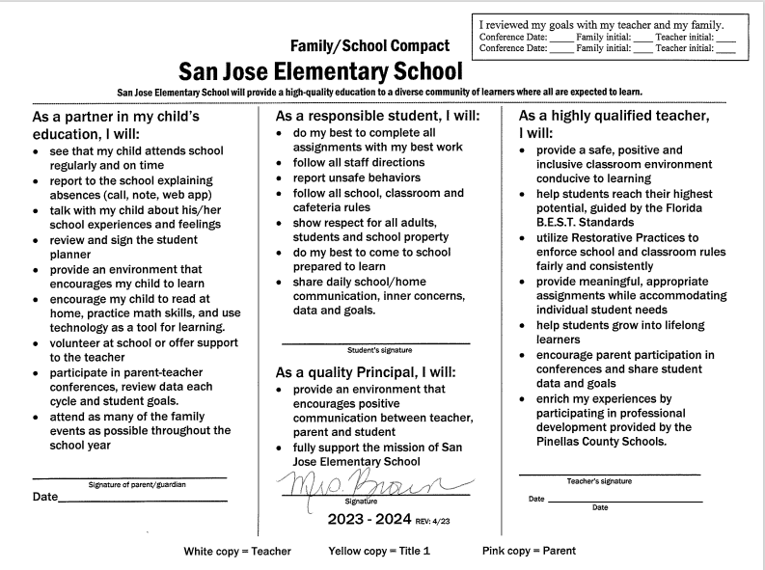
San Jose Compact
Notes:
Please insert the an example of your updated school compact. Highlight any things that unique to your school’s compact.

Slide 12
Parent and Family Engagement Plan (PFEP)
The PFEP Sections include information about the following:
Parent trainings to increase student achievement
Staff trainings for engaging parents
Communication methods between home and school
Flexible meeting times
Accessibility for parents
Coordinating with other Federal Programs
Notes:
Provide information on the specific committees that parents can be involved. Include the purpose, date and time of meetings.
Explain the PFEP and its purpose.
Consider the evidence related Title I Crate, Sample of Evidence,

Slide 13
Florida Benchmark For Excellent Student Thinking Standards (B.E.S.T). You may read more information by visiting, www.fldoe.org.
Notes:
All curriculum, instruction and assessments are based on student-centered expectations.

Slide 14
Accountability
School Report Cards
School Grade and Overview
Population and Enrollment
Assessments – Academic Achievement, Growth, and Population
Assessments – English Language Learners
Graduation and Beyond
Educator Qualifications and Equity
Long-Term Goals and Interim Progress
Accelerated Course Enrollment
Per-Pupil Expenditures
National Data
Available online at https://edudata.fldoe.org/

Slide 15
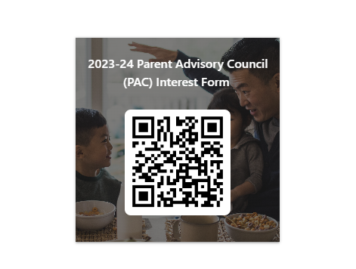
Parent Advisory Council (PAC)
The District has a Parent and Family Engagement Plan. The summary of the plan is in the Title I School & Family Partnership Overview.
You may access the full plan at www.pcsb.org/titleone
The Parent Advisory Council (PAC) is responsible for reviewing and revising the District PFEP.
PAC will meet virtually or in-person with the district’s Title I staff.
Each school is committed to having at least one member representative on PAC.
PAC meets twice a year, if you are interested in representing our school please notify, Insert contact person
Notes:
Please add your PAC representative in slide and share with your Title I Specialist.
https://forms.office.com/r/r5daaMTENE\

Slide 16
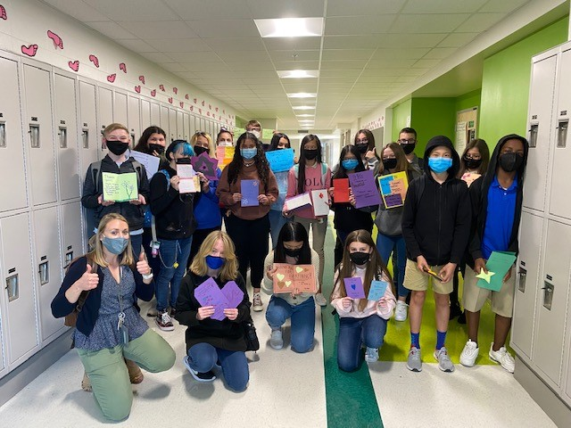
Additional Resources
Learning at Home Family Resources - https://www.pcsb.org/Page/32836
Volunteer in a Pinellas County School - https://www.pcsb.org/Page/459
Parent Academy POWER HOURS Webinars - https://www.pcsb.org/Page/26534
Partnerships - https://www.pcsb.org/Page/418

Slide 17
Thank you for your time!

